Slide 1


Smart Healthcare Appointment System
A healthier world starts with smarter systems
GITHUB LINK:
https://github.com/vaishusubramani145/SmartCare

Slide 2


TITLE AGENDAS
Introduction
Problem Statement
Objectives
Why its matter know?
Tools and Technologies
Design Process
Expected Outcome
conclusion

Slide 3
INTRODUCTION
The Smart Healthcare Appointment System is an online-based system designed to ease the process of managing hospital appointments.
It connects patients, doctors, and administrators in one secure system.
Patients can easily book appointments, access their prescriptions, and join teleconsultations online.
Doctors will be able to manage schedules and records with real-time updates.
This system provides faster, safer, and smarter health care to all.

Slide 4
PROBLEM STATEMENT:
With the present healthcare system, patients have to face lengthy waiting times, mismanagement of appointments, and troubles with accessing their medical records.
Communication among patients, doctors, and administrative staff in hospitals is often fragmented and disorganized.
Many clinical facilities still use manual or semi-digital processes that result in errors and inefficiency.
There is a lack of an integrated system that manages appointments, prescriptions, and teleconsultations in one place.
Therefore, a smart healthcare appointment system will be required to smoothen the scheduling, improve communication, and securely provide centralized access to healthcare services.

Slide 5
OBJECTIVE:
To develop a centralized healthcare platform that manages appointments, prescriptions, and medical reports efficiently.
To design user-friendly interfaces for patients, doctors, and administrators with easy navigation.
To integrate teleconsultation and reminder features for better accessibility and time management.
To ensure data privacy and security by following healthcare compliance standards.
To improve the overall communication and coordination between patients and healthcare providers.

Slide 6
WHY IT’S MATTER KNOW?
People in this digital era will seek health care services that are easy and quick to access.
But many patients still encounter delays, confusion, and poor coordination in booking appointments or consulting doctors.
A Smart Healthcare Appointment System helps reduce waiting time, increases the efficiency of the hospital, and improves patient satisfaction.
This ensures medical data, prescriptions, and reports are available anytime and anywhere, securely and with ease.
This system is designed to enable superior health outcomes and modernize the whole care experience, all by making healthcare smarter and more connected.

Slide 7
TOOLS AND TECHNOLOGIES:
TOOLS:
TECHNOLOGIES:
Frontend: HTML, CSS, JavaScript, React.js (for building responsive interfaces).
Backend: Python (Flask/Django) or Node.js (for managing server-side operations).
Database: MySQL or MongoDB (for storing user, appointment, and report data).
APIs: Integration for teleconsultation, reminders, and notifications.
Security: Data encryption and HIPAA-compliant privacy measures.
Figma – For designing user interfaces and creating interactive prototypes.
Miro – For user journey mapping and brainstorming ideas.
Adobe XD – For designing alternate mockups and visual layouts.
Useberry – For usability testing and gathering user feedback.
Google Sheets – For data mapping, content organization, and project tracking

Slide 8
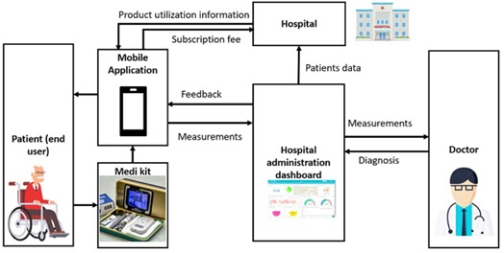
FLOW DIAGRAM AND USER FLOW:
USER FLOW:
patient → login->search doctor->book
Appointment->teleconsultation->receive
Prescription->view reports->doctor->login
->manage schedule->teleconsult->write
Prescription admin->->login->monitor
Analytics->manage users

Slide 9
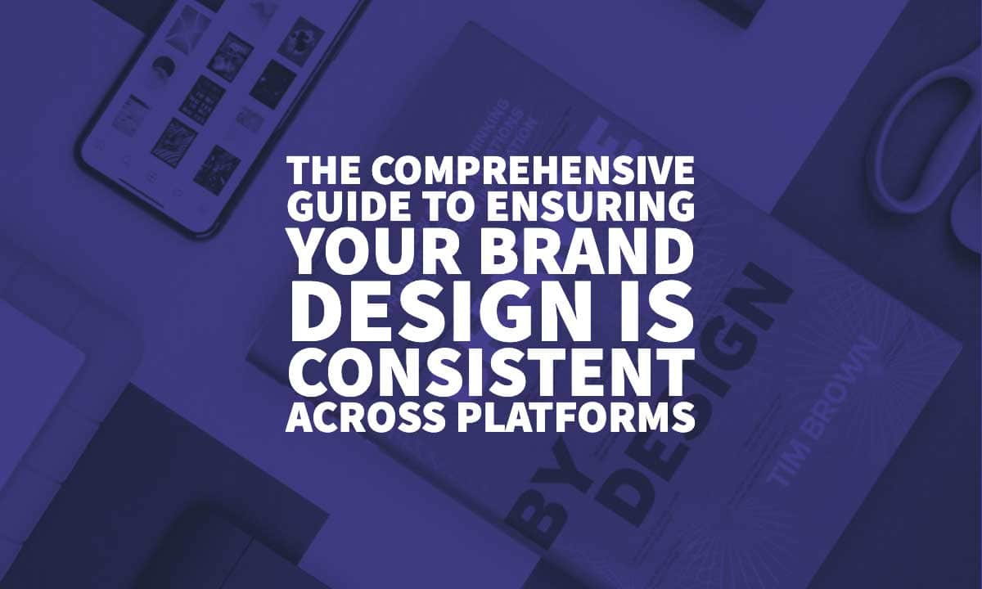
DESIGN PROCESS:
The Smart Healthcare Appointment System prototype in Figma helps design a user-friendly healthcare platform.
It includes screens for login, patient and doctor dashboards, appointment booking, and teleconsultation.
Using modern colors, smooth animations, and clear navigation, it creates an interactive design that improves
communication and simplifies hospital appointment management efficiently.

Slide 10
EXPECTED OUTCOME:
The expected outcome of the Smart Healthcare Appointment System is an interactive
and efficient digital platform that connects patients, doctors, and administrators in one place.
It enables easy appointment booking, teleconsultation, and access to medical records.
The system improves communication, reduces waiting time, ensures data security,
and enhances overall healthcare experience.
https://www.figma.com/make/Uhuysom3kCkAlx2AchN0Sd/Smart-Healthcare-Appointment-System?node-id=0-1&p=f&t=mNt8SCMixqPl6v08-0&fullscreen=1
Link:

Slide 11
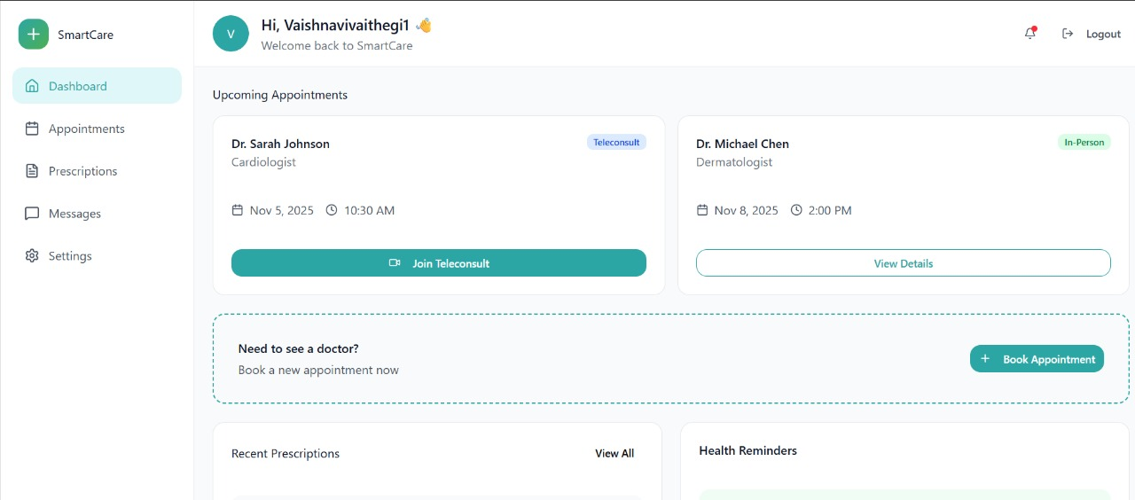
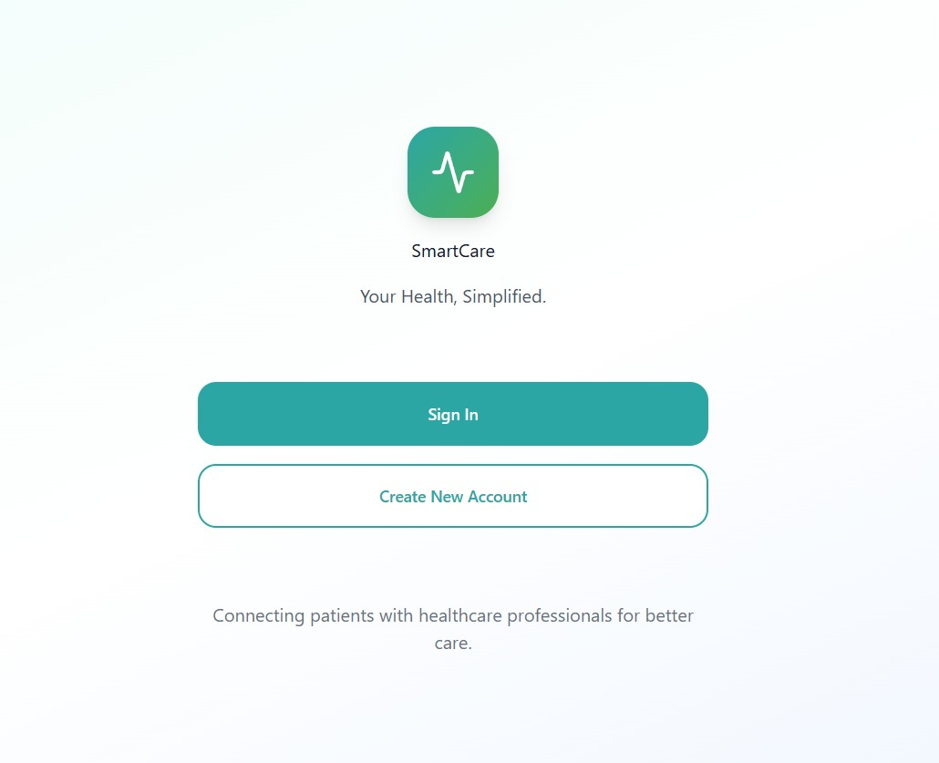
SIGN IN PAGE
HOME PAGE

Slide 12
CONCLUSION
The Smart Healthcare Appointment System provides a modern solution to manage healthcare services efficiently. It reduces patient waiting time, simplifies appointment scheduling, and improves communication between doctors and patients. With features like teleconsultation and digital reports, it ensures quick, secure, and convenient healthcare access. This system promotes a smarter, more connected, and patient-friendly healthcare experience for the future.

